Slide 1
Digital Payments Data Analysis
Prepared by: Sindhu Ravuri
Email: sindhu@gmail.com
LinkedIn: https://www.linkedin.com/in/sindhu-ravuri-99a950381/

Slide 2
Project Overview
Dataset: Digital Payment Trends (500 records)
Tools Used: PySpark, Pandas, Matplotlib
Goal: Analyze global digital payment trends and identify adoption patterns.
Time Period: 2018–2025
Focus: Growth, Adoption Rate, and Regional Comparison

Slide 3
Dataset Description
Key Columns:
• payment_method – UPI, Credit Card, BNPL, NFC, etc.
• region – Geographic zone of transaction
• industry – Sector (Retail, Healthcare, Education)
• adoption_rate_% – Digital payment adoption rate
• growth_rate_% – Annual increase in adoption
• transaction_volume_usd – Total value of payments
• trend_summary, key_driver, challenge – Textual insights

Slide 4
Data Cleaning & Preprocessing
No missing or null values found.
Verified correct column data types.
Checked unique categories in payment_method and region.
Calculated averages for adoption rate, growth rate, and transaction volume.
Ensured consistent date formatting (2018–2025).

Slide 5
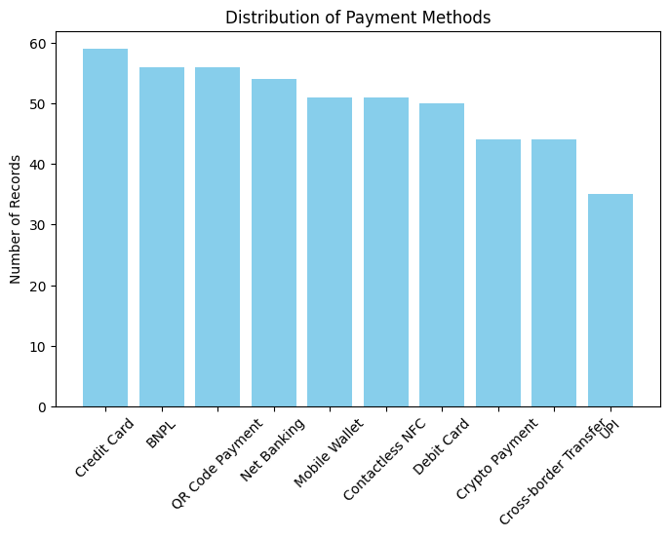
Distribution of Payment Methods

Slide 6
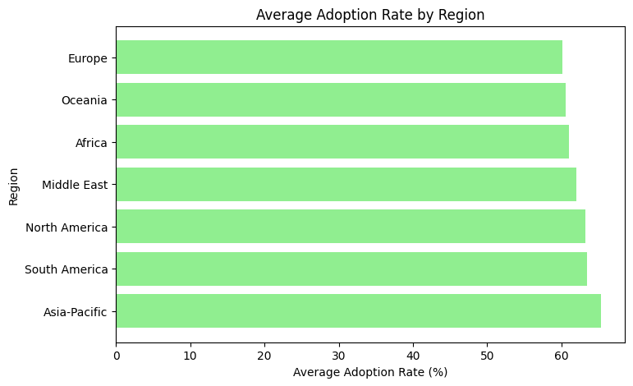
Average Adoption Rate by Region

Slide 7
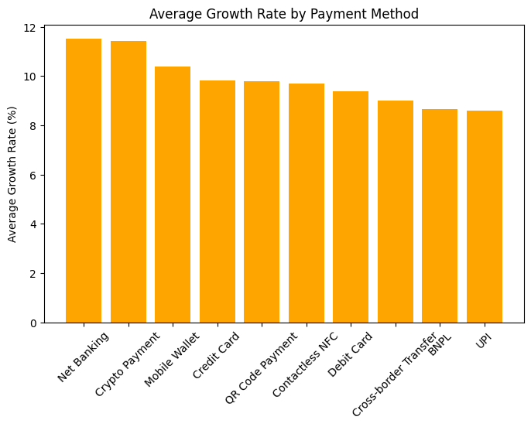
Average Growth Rate by Payment Method

Slide 8
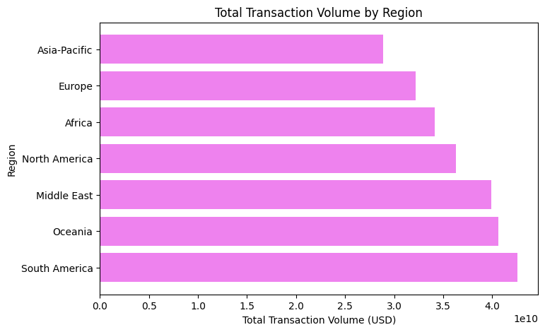
Total Transaction Volume by Region

Slide 9
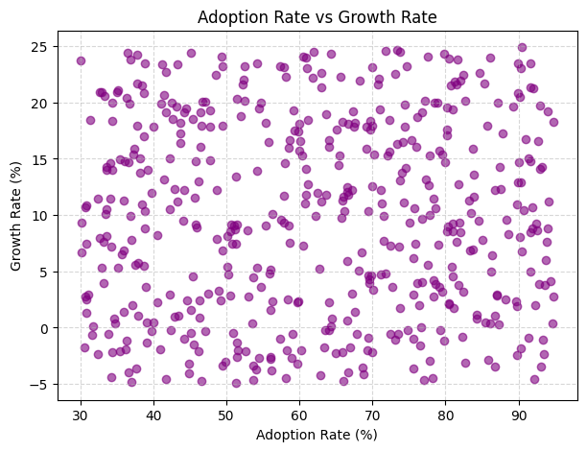
Relationship Between Adoption Rate and Growth Rate

Slide 10
Key Insights
Average Adoption Rate: ≈ 68% globally.
Average Growth Rate: ≈ 10–12% yearly
Highest Transaction Volume: North America (over $800M average).
Most Prominent Payment Driver: Consumer convenience and smartphone use.
Most Frequent Challenge: Data privacy and technical outages.

Slide 11
Conclusion
• Digital payments are rapidly transforming the global economy.
• Contactless, BNPL, and UPI methods lead the future of transactions.
• The dataset confirms strong regional and sector-based variations.
• Reshmi Kumari’s analysis highlights real-world fintech growth patterns.

